Slide 1
Violence Reduction
and Access to Higher Education
Post-Conflict Evidence from Colombia
Juliana Aragon Acevedo
Capstone advisor: Eleanor Power
MSc. ASDS – Methodology Department LSE
May 8th, 2026
1. Motivation
2. Context
3. Research Design
4. Challenges and limitations
5. Next Steps

Slide 2
Motivation
THEORETICAL FRAMEWORK AND GAP
RESEARCH QUESTION
How does the reduction of violence following the Colombian peace agreement affect access to higher education in municipalities most exposed to FARC violence?
Human capital theory
Education raises income and productivity, promoting development and social mobility. Returns to higher education are significant and grow over time (Becker 2002; Psacharopoulos & Patrinos 2018).
TWO PLAUSIBLE CAUSAL MECHANISMS
Conflict disrupts human capital accumulation
Armed conflict reduces enrolment, increases dropout, and lowers performance — documented in Iraq, Bosnia, Peru, Rwanda, and Colombia (Jürges et al. 2022; Soler 2016; Fergusson et al. 2020).
1
Security ↑
Violence reduction allows youth to complete secondary school and physically access HE institutions (Peña & Dorussen 2021).
Violence reduction — unknown effect on higher education
2
Academic performance ↑
Prior work shows that peace can aid educational recovery at primary/secondary levels (Prem et al. 2023; Montaño-Bardales & Palacios 2025), but no evidence exists for higher education.
Improved test scores and graduation rates post-ceasefire strengthen HE admission eligibility (Prem et al. 2023 and Montaño-Bardales & Palacios, 2025).
1. Motivation
2. Context
3. Research Design
4. Challenges and limitations
5. Next Steps

Slide 3
Context: Why Colombia?
CONFLICT TIMELINE
HUMAN COST 1995–2018
450,664
752,964
121,768
50,770
1964
lives lost
displaced
disappeared
kidnapped
FARC & ELN founded — Ideological conflict inspired by communism and Cuba revolution
1980s
WHY THIS CASE IS IDEAL
AUC paramilitaries emerge; drug trafficking transforms the conflict
2012
The longest conflict in the Western Hemisphere that has been extensively studied, but higher education is unexplored
Peace negotiations with the FARC guerrilla began in Havana - Cuba
Peace agreement provides a clear exogenous shock for causal identification
Dec 2014
A bilateral ceasefire between FARC and the Colombian Government was declared
Rich municipal and individual-level data from public institutions
Nov 2016
Signing of the final Peace Agreement
Prior studies confirm effects on primary/secondary, and this study will extend the evidence upward
1. Motivation
2. Context
3. Research Design
4. Challenges and limitations
5. Next Steps

Slide 4
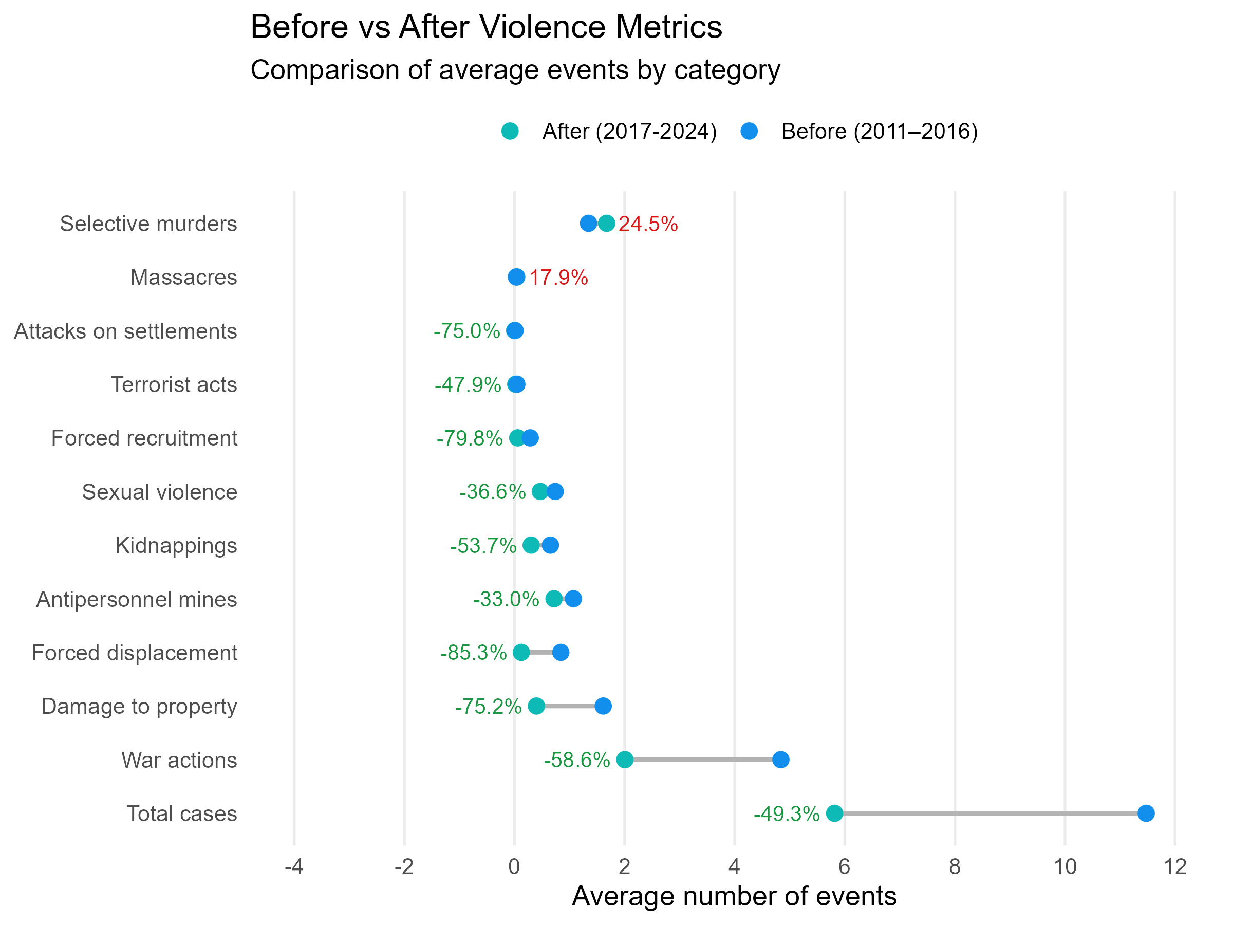
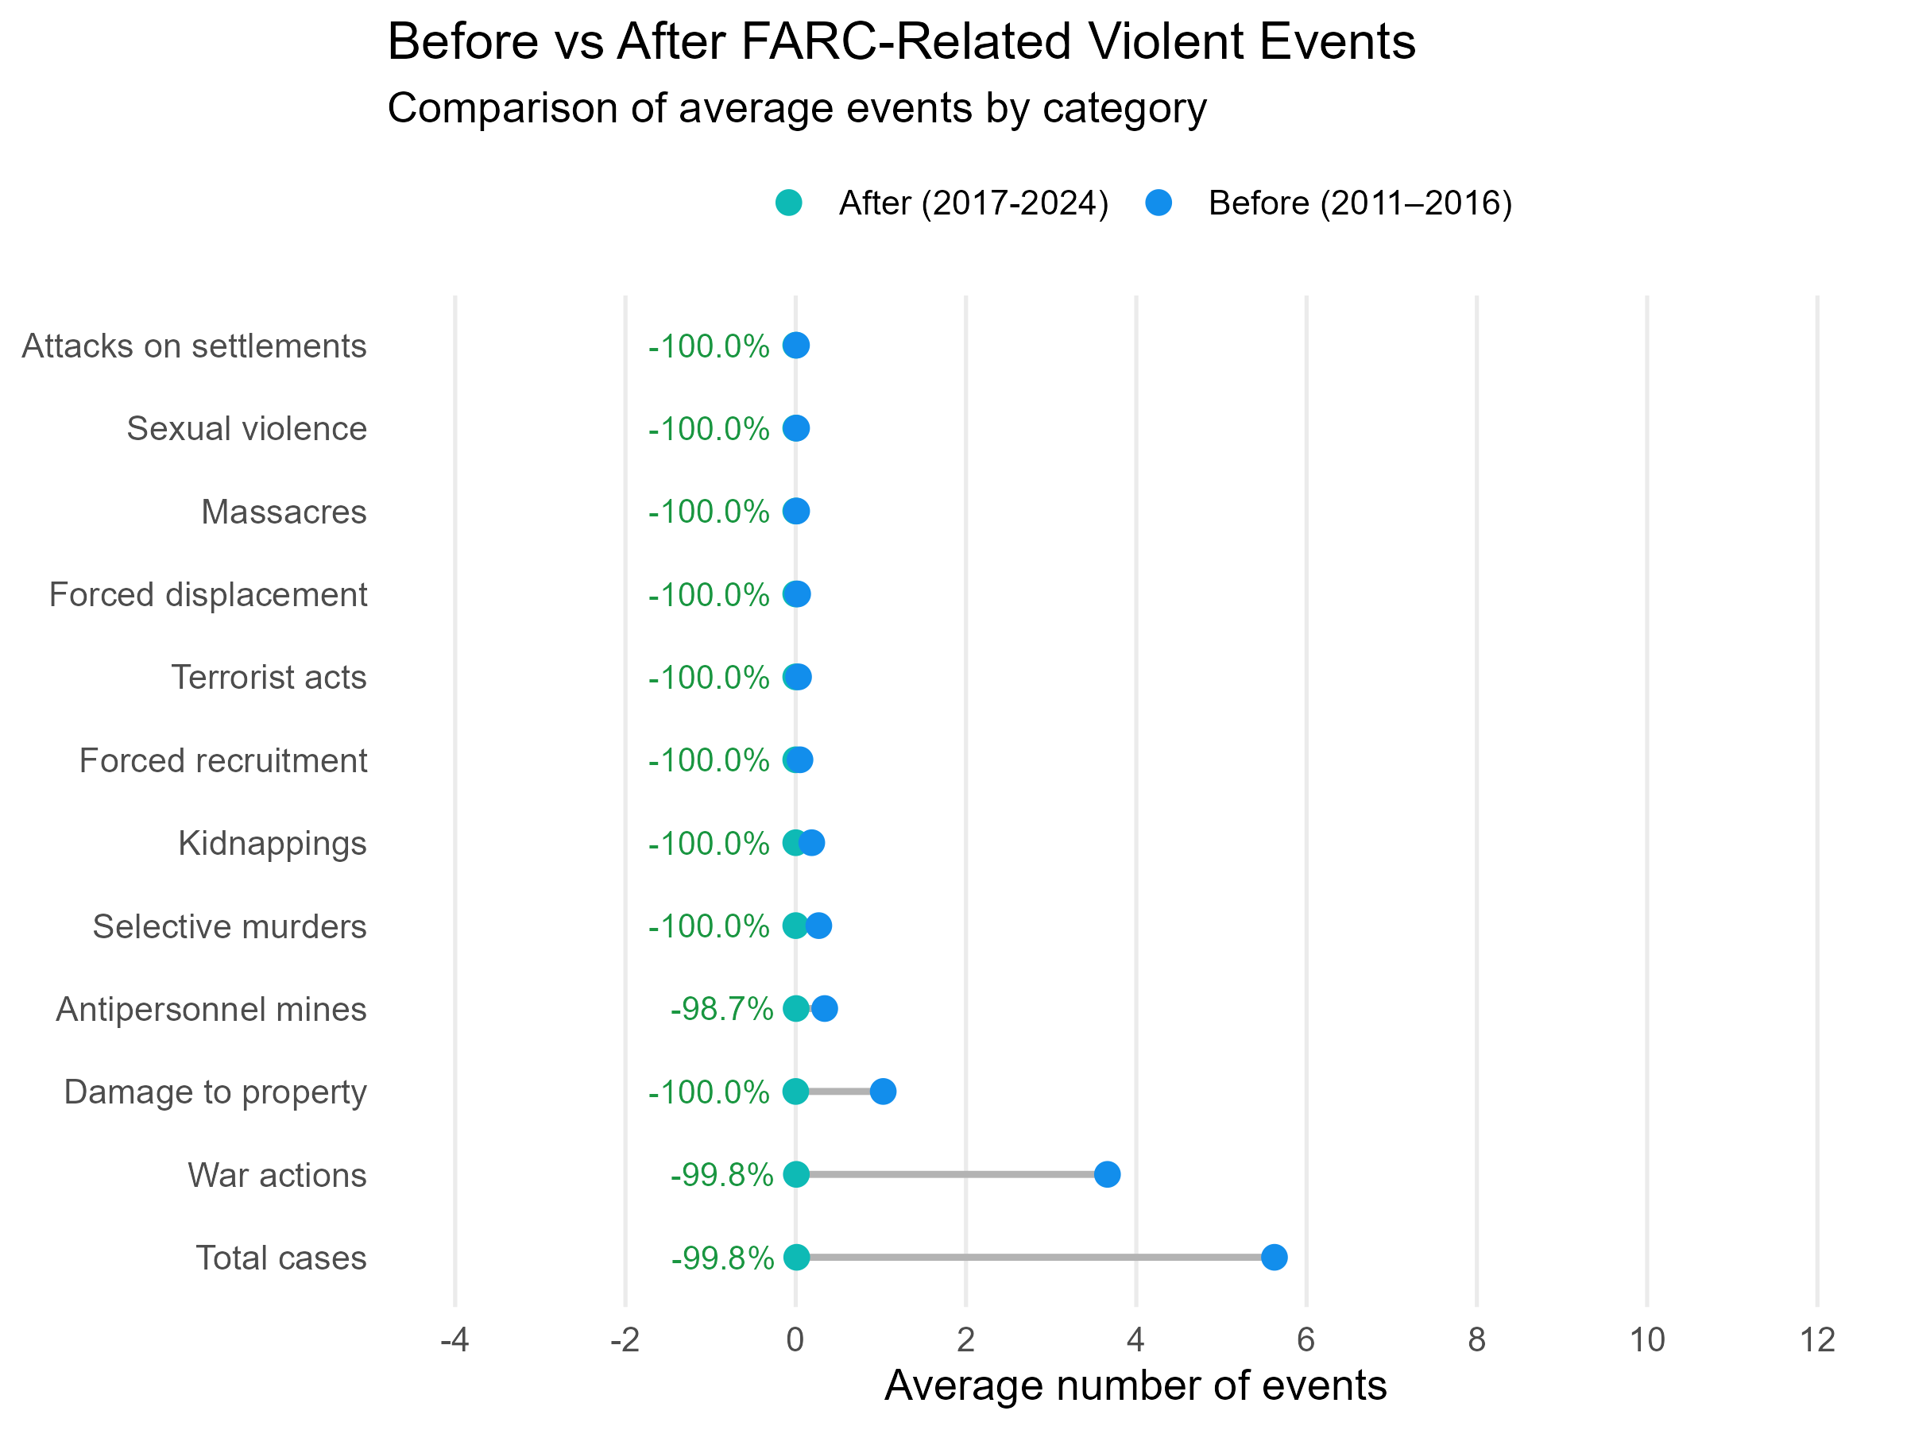
Context: Has violence declined?
Source: Author’s calculations based on conflict event data from the Colombian National Center of Historical Memory. The figure reports the average annual number of violent events related to civil conflict by category before (2011–2016) and after (2017–2024) the 2016 peace agreement.
Source: Author’s calculations based on conflict event data from the Colombian National Center of Historical Memory. The figure reports the average annual number of FARC-related events by category before (2011–2016) and after (2017–2024) the 2016 peace agreement.
1. Motivation
2. Context
3. Research Design
4. Challenges and limitations
5. Next Steps

Slide 5
Research Design
IDENTIFICATION STRATEGY
DATA
Difference-in-Differences (DiD)
Outcome
ICFES – NATIONAL MINISTRY OF EDUCATION 2011-2024
The DiD compares changes in the rate of transition to higher education between treated and control municipalities, before and after the 2016 peace agreement.
The peace agreement provides a clear before-and-after threshold and well-defined treatment groups based on pre-existing FARC presence.
DiD differences out municipality-level time-invariant factors (via municipality FE) and common temporal shocks (via year FE).
Transition rate to higher education: proportion of secondary graduates in each municipality who enroll in a HE (technical, technological, or university) the following year.
Annual, municipal level, based on individual data.
Treatment
NATIONAL CENTER OF HISTORICAL MEMORY – CNMH 2011 - 2024
FARC-related violent events per municipality. Treatment dummy = 1 for municipalities where FARC events per capita are in the top three quartiles during 2011–2016, followed Prem et al. 2023.
Key assumption
Parallel trends: absent the agreement, transition rates in treated and control municipalities would have followed similar trajectories.
No anticipation: treated municipalities did not adjust behaviour before the agreement took effect.
Controls
ADMINISTRATIVE DATA – NATIONAL DEPARTMENT OFFICE
Tax income, national transfers, public expenditure, and hectares under coca cultivation.
Panel: 1,122 municipalities × 2011–2024
1. Motivation
2. Context
3. Research Design
4. Challenges and limitations
5. Next Steps

Slide 6
Challenges and limitations
FARC-only scope
Confounding educational policies
The agreement covers FARC exclusively. ELN, paramilitaries, and successor groups continue operating, and their violence may attenuate or confound the estimated effect.
The HE access programmes (Ser Pilo Paga, Generacion E) overlap with the treatment period. Year FE absorbs common shocks, but differential program penetration in treated municipalities would confound the estimate.
→ Include the other conflict actors’ activity index as a control variable
→ Check available information to control for the program incidence per municipality.
Treatment measure
Parallel trends and spillovers
A single threshold to classify high/low FARC exposure loses within-group intensity variation. Different cutoffs (median, percentiles) may produce different results.
The key DiD assumption must be validated empirically.
Additionally, violence reduction in treated municipalities may affect neighbours (SUTVA concern), contaminating the control group.
→ I will check treated municipalities and their locations.
→ Robustness checks with multiple thresholds and a continuous exposure measure
1. Motivation
2. Context
3. Research Design
4. Challenges and Limitations
5. Next Steps

Slide 7
Next Steps
1
2
3
Violence measure and descriptive
analysis
Main Estimation & Robustness
Extensions
Construct FARC exposure measure at multiple thresholds
Two-way FE DiD with municipality and year FE, SE clustered at the municipality level
Heterogeneity analysis by gender
Map treated vs. control municipalities geographically
ELN and coca hectares as additional controls
Alternative violence thresholds (median, percentiles) and continuous exposure
Plot pre-treatment trends visually (2011–2016)
Summary statistics by treatment group
Sensitivity to treatment date (2014 ceasefire vs. 2016)
1. Motivation
2. Context
3. Research Design
4. Challenges and Limitations
5. Next Steps

Slide 8
Capstone plan
Time: Mid may – Last week of June
Data construction
Descriptives & pre-trends
Main DiD estimation
Armed conflict database OK
Treatment measure
Higher education access measure per municipality. Work in progress
Control variables per municipality.
Construct municipal panel 2011-2024
Treated vs. control map of municipalities
Summary statistics by treatment group
Raw time-series of transition rates by treatment group, 2011–2024
Event-study plot — leads and lags around 2016 to test parallel trends assumption.
Two-way FE: municipality and year, SE clustered at municipality
Three specs: outcome only / + controls / + specification with interaction between other armed conflict actors and treatment variable
It will be ready by:
2 weeks – First week of June
23rd may – 6th June
1 week– Second week of June
7th -13th June
2 weeks – Third and fourth weeks of June : 14th -27th

